Slide 1
Human Trafficking and Labour Exploitation in Supply Chains
OLA and SMA Webinar
Tuesday, 15 February 2022

Slide 2
Aims of this Webinar
Overview of Labour Exploitation and the role of Human Trafficking
The scale of the problem
Understanding factors causing Labour Exploitation

Slide 3
How many do you use or consume?

Slide 4
What is Labour Exploitation?
Contested definitions
Various names, often interchangeable
Forced labour (used in this webinar)
Modern slavery
Forced Labour
Not just substandard or exploitative working conditions
Restrictions on freedom of movement; withholding of wages or identity documents; threats; intimidation
Human trafficking does not require the crossing of national or internal borders.

Slide 5
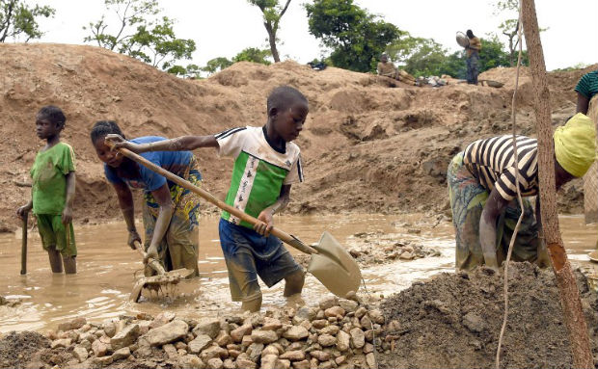
How many people are in forced labour?
Numbers are typically estimates
Methods of counting are improving
Difficult to fully quantify as hidden
In 2016, there was an estimated:
40 million people in modern slavery
25 million people in forced labour
1 in 4 victims of modern slavery are children
Women and girls are disproportionately affected by forced labour
99% in sex industry; 58% in other sectors

Slide 6
Example 1 – Starbucks, Nespresso
Global brands – Nespresso was fronted by George Clooney
Children under-13 working 40+ hour weeks in ‘gruelling conditions’ in Guatemala
Some children as young as 8 y/o
Earning as little as 31p/hour
In contrast, Starbucks has global revenue of more than $25 billion

Slide 7
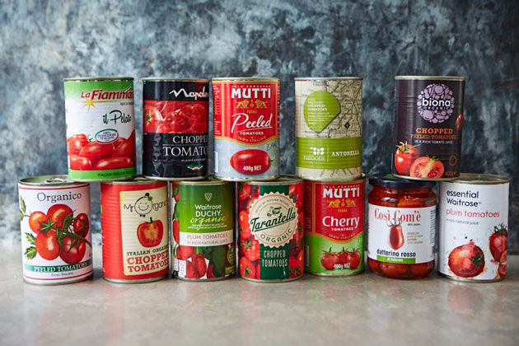
Example 2 – Tinned Tomatoes
Over 400,000 agricultural workers at risk of exploitation and 100,000 living in inhumane conditions – UN SP in 2018
Estimated to be 50,000 enslaved agricultural workers in Italy
Drawn from migrant centres
Sicily and Calabria
12 hour shifts in 40 degree heat
Meagre wages are used to buy over-priced essentials from gang-masters [mining town]

Slide 8
Factors Associated with Vulnerability to Trafficking and Forced Labour
Poverty
Marginalisation
Gender and Age
Weak social network
Lack of legal protection
Lack of education
Disability – mental, intellectual, etc.
Political or economic context of country of origin
Irregular immigration status

Slide 9
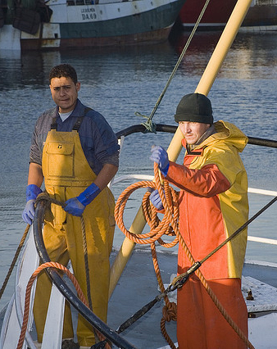
Forced Labour in Ireland
Case of Migrant Fishermen
39-hour contracts but worked 100+ hours with avg. pay of €2.82/hour
Experienced verbal and/or physical abuse
Work experience meets the criteria for trafficking and forced labour
Potential number of 500 non-EEA crew on Irish fishing ships.
Undocumented status is vulnerable to trafficking and labour exploitation

Slide 10
Effect of Covid-19 on Labour Trafficking
Root causes of human trafficking have been ‘exacerbated and brought to the forefront’. – UNODC
Created best circumstances for employers to exploit increasingly vulnerable people
Recruitment has moved further online leading to more ‘hiddenness’

Slide 11
Why is it so difficult to solve?
Weak enforcement of laws
Socio-economic vulnerability of individuals, families and workers
Economic and commercial pressures facing suppliers with global supply chains
Pressure to reduce input, raw material or processing costs
Temptation to utilise lax labour standards to reduce labour costs

Slide 12
Thank You

