Slide 1
ST PATRICK’S MISSIONARY SOCIETY ALTERNATIVE ENERGY PROJECT

Slide 2
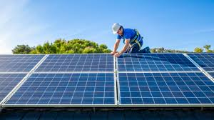
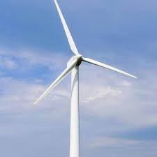
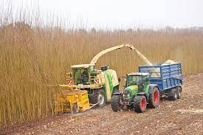
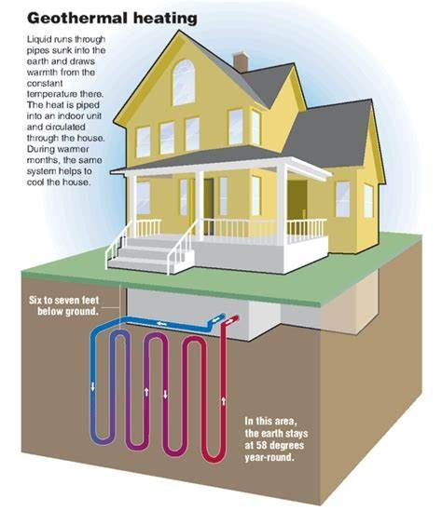
St Patrick’s, Kiltegan, Co. Wicklow
ALTERNATIVE ENERGY SOURCES

Slide 3
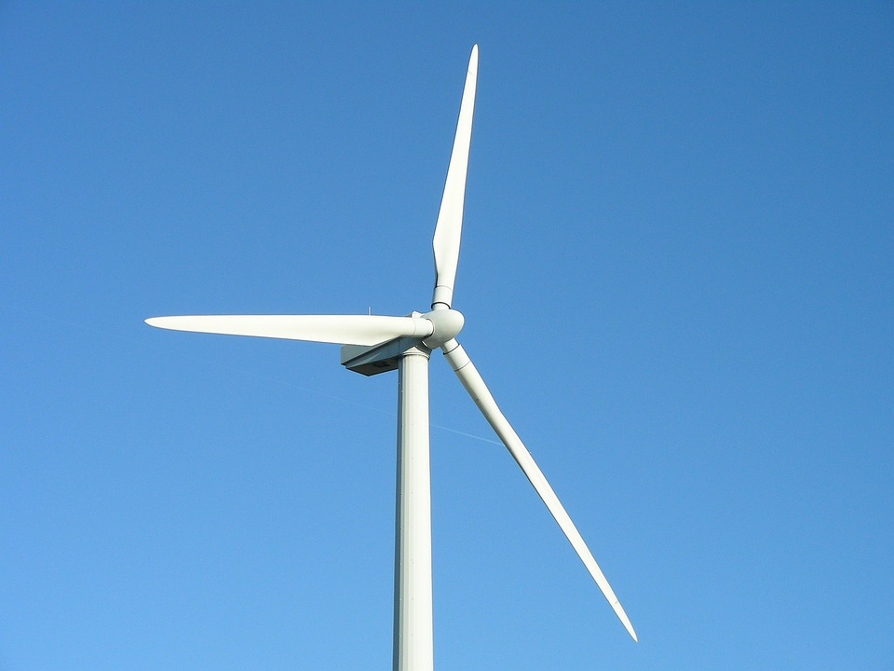
WIND TURBINE
Installed 2012
150 kW
Cost €160,000
Savings €30,000 per year
Payback 6 – 7 years
Return on investment 16% per annum
Reconditioned Sept 2021
Cost €80,000
170kW
Estimated savings more than €40,000
Payback 2 years

Slide 4
WIND TURBINE PRODUCTION FOR 6 MONTHS (OCT ’21 TO MARCH 22)
Total saved on electricity bill in six months (October 2021 to March 2022) = €29,247
Month | Meter Reading | Monthly Production | Power Exported | Export Price | Used on Compound | Value of power used | TOTAL SAVINGS
30.9.21 | 2,692 | 2,692kWh
October | 11,850 | 9,158kWh | 3,792 | €604 | 5,366 | €1,958 | €2,562
November | 23,823 | 11,973kWh | 4,609 | €772 | 7,364 | €2,596 | €3,368
December | 41,101 | 17,278kWh | 7,540 | €1,501 | 9,738 | €3,952 | €5,453
January | 53,759 | 12,658kWh | 4,128 | €486 | 8,530 | €3,326 | €3,331
February | 86,682 | 32,923kWh | 12,947 | €1,767 | 19,976 | €7,470 | €9,237
March | 102,860 | 16,178kWh | 5,689 | €1,171 | 10,489 | €4,125 | €5,296
6 month Total |  | 102,860kWh | 38,705 | €6,301 | 61,463 | €23,427 | €29,247

Slide 5
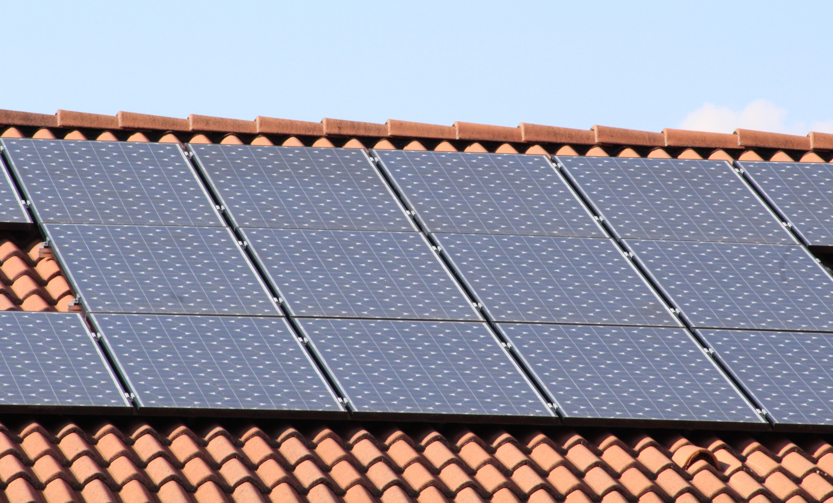
Solar PV Panels
112 PV panels installed on roof 2016
Capacity production 30kW
Project cost €51,000
Payback period at 2016 rates ≳ 12 years
Annual production ≥ 30,000kWh (units)
Annual savings at present rate (45c per unit) = €13,500
Payback at present rate = 4years

Slide 6
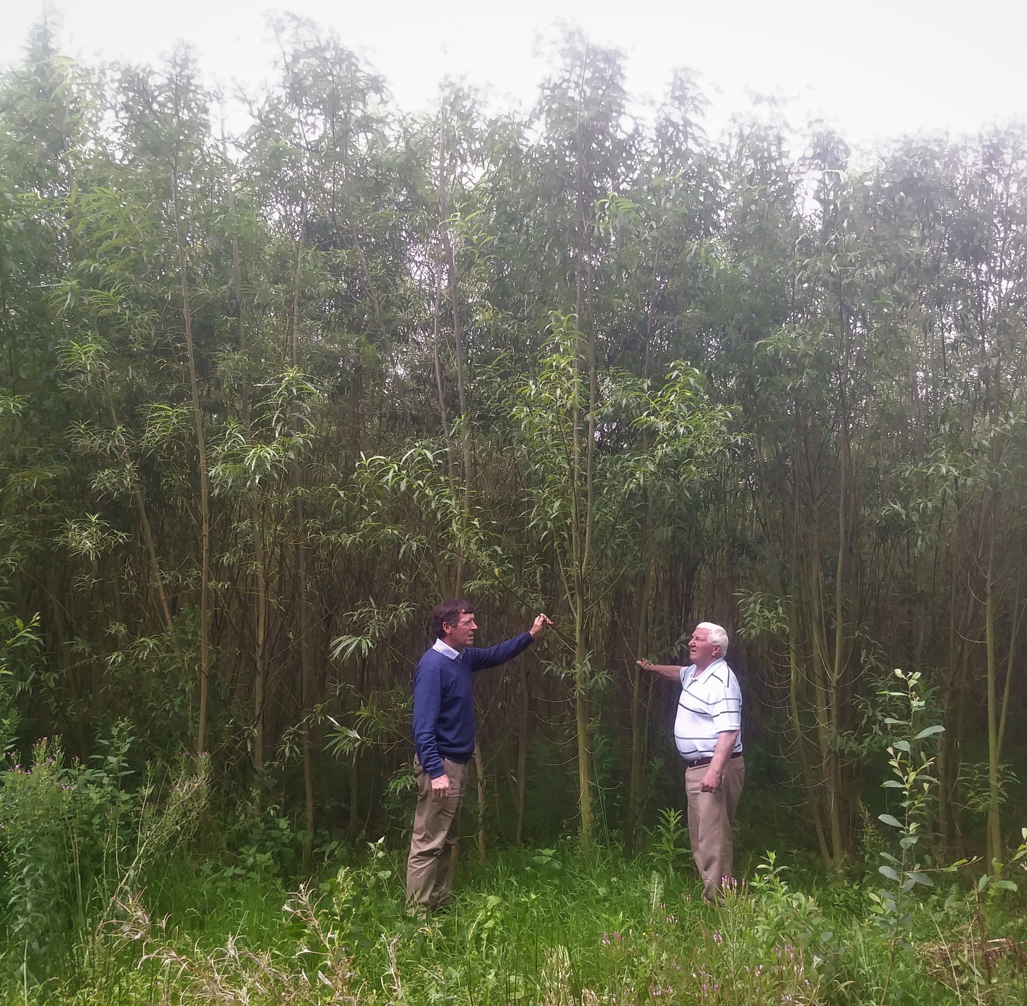
BIOMASS PROJECT
Initiated Spring 2018
34 acres of willow planted
First harvest 13 acres – Winter 2020
Harvest every 2 years
Planting lasts 20 years

Slide 7
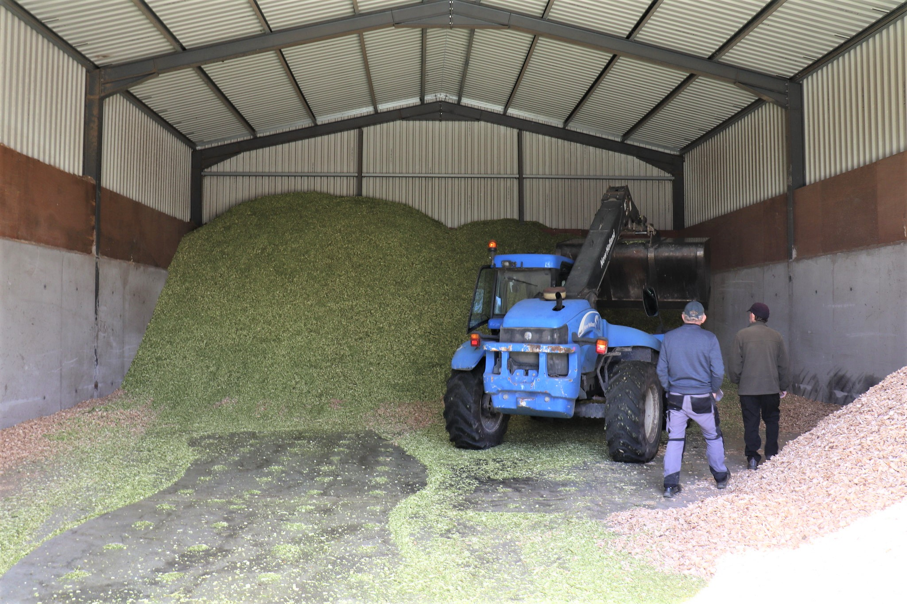
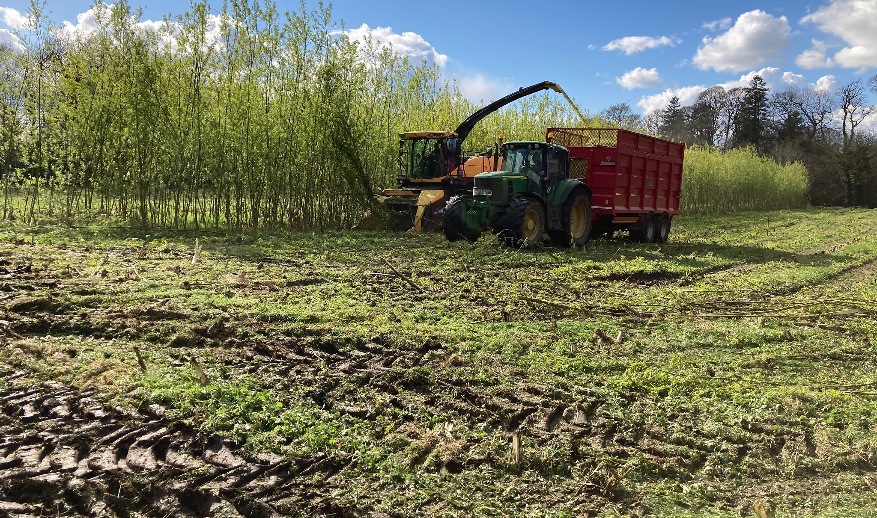
BIOMASS PROJECT
Willow is carbon neutral
Attracts wildlife
Fast growing
Good calorific value
Requires no artificial fertilizer

Slide 8
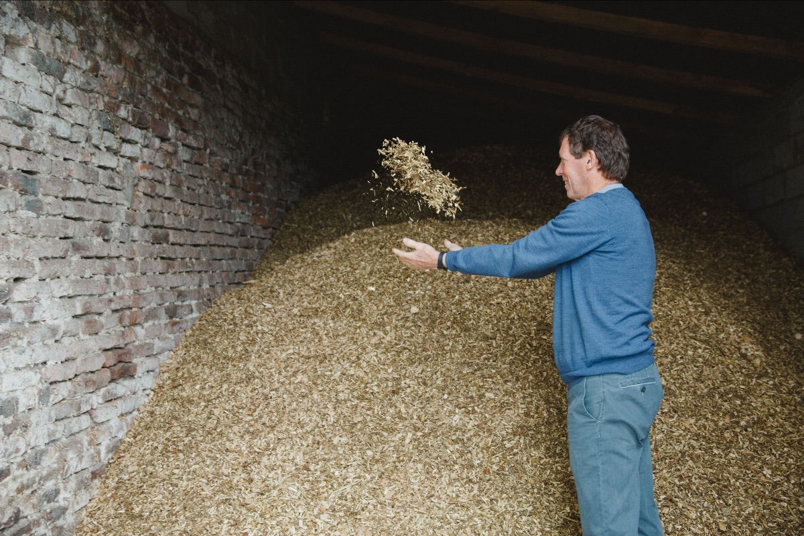
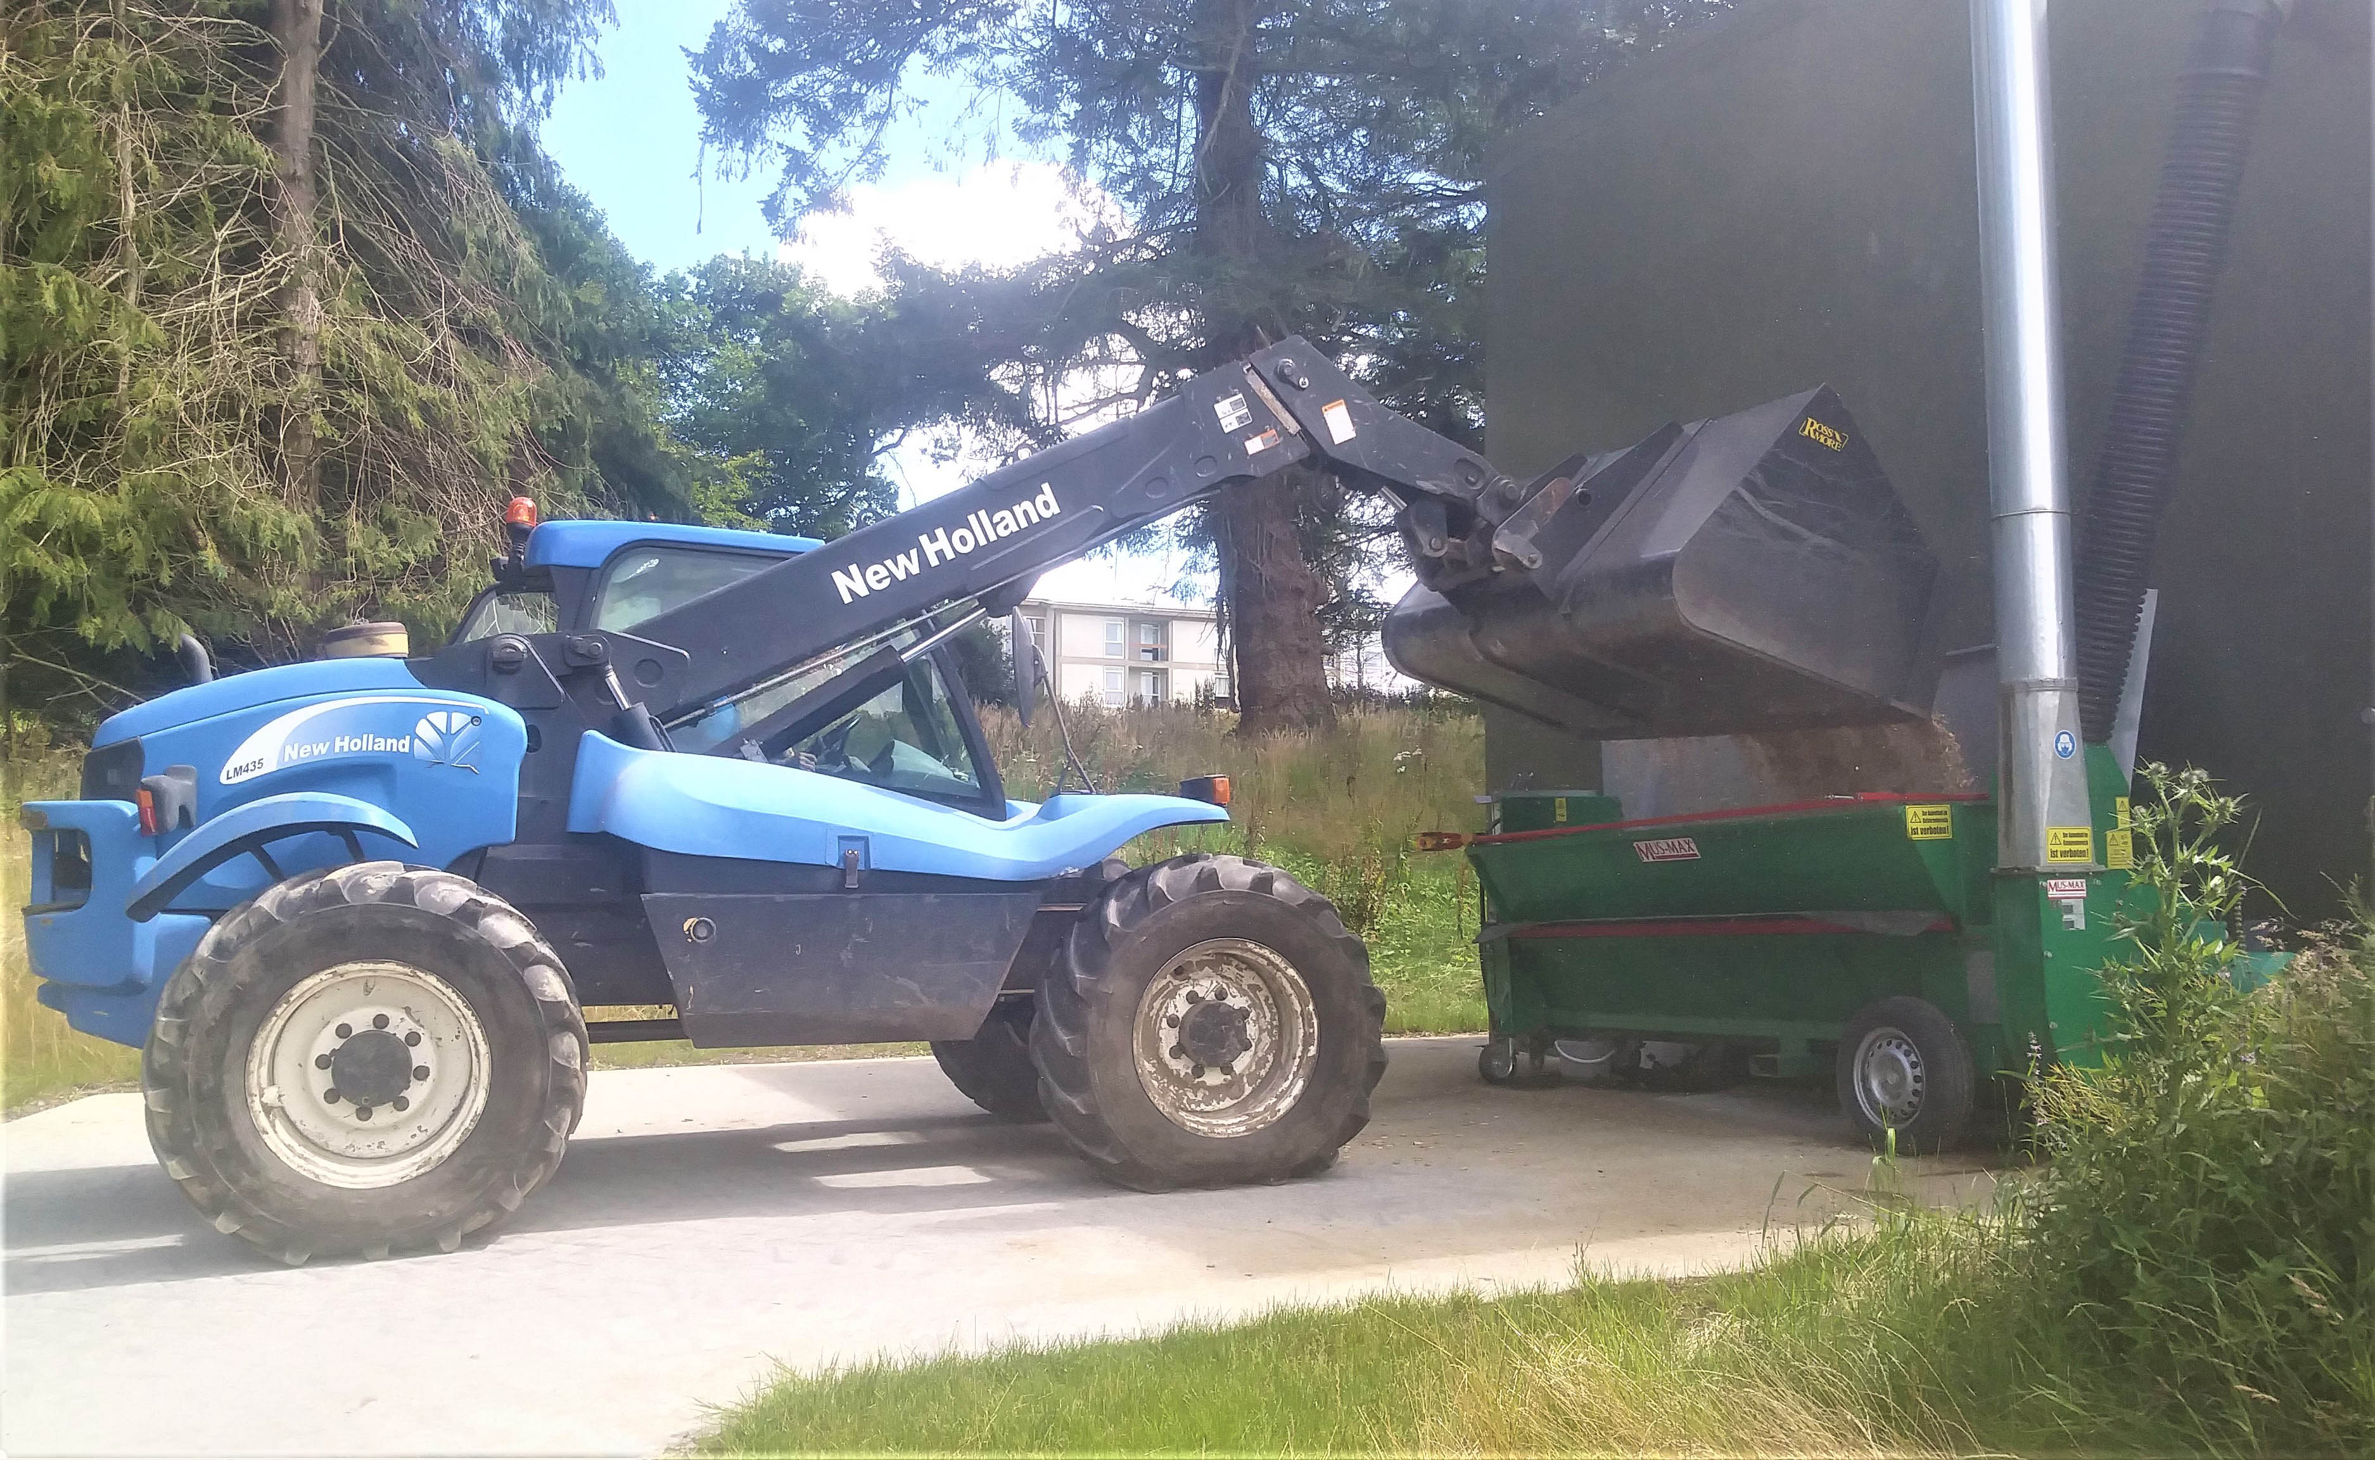
BIOMASS PROJECT
Replacing 45,000 litres oil per year
Providing central heating and hot water for four large buildings
Considerable heating cost savings
Environment friendly land use
Good return on investment
Relatively easy to manage
Government grants too complicated

Slide 9
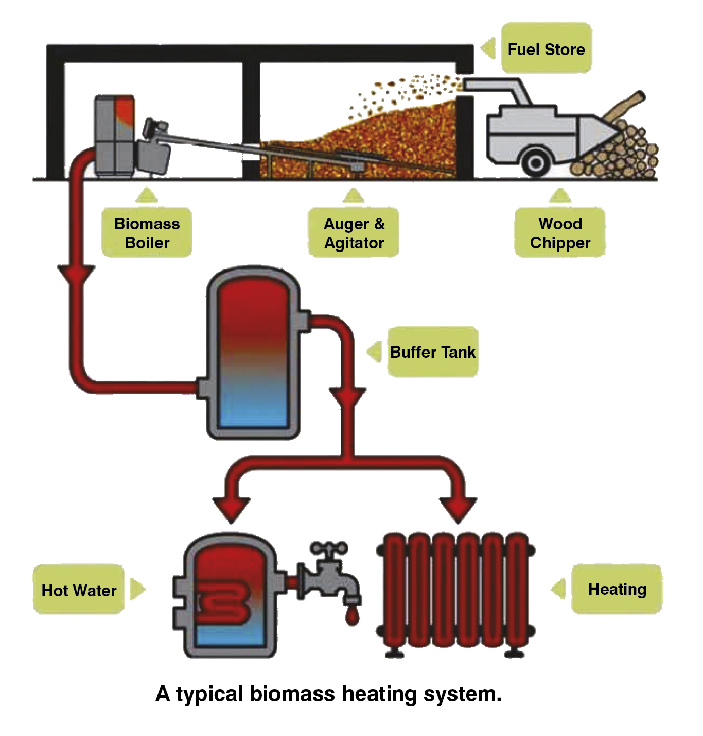
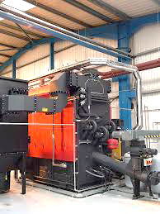
BIOMASS HEATING SYSTEM

Slide 10
